Slide 1
Density and Priority Based Traffic Signal Control System

Slide 2
Problem at hand
One of the major problems commuters face everyday is mismanaged traffic signals. The length of the signal does not correspond to the number of vehicles on the road, and this causes various issues. For example, in the current system, if there is no vehicle on a particular side of the road, that signal still functions on a fixed time delay, turning green, despite there being vehicles at the other signals. This causes frustration to the driver, leading to serious problems such as road rage, and causes people to “jump” a signal.
To solve this problem, our team intends to build a traffic density monitoring system, that smartly changes the signal based on the vehicular density on each lane.

Slide 3
Components being used
Arduino Microcontroller
Infrared Proximity Sensors
RF ID Reader Module
RF ID Tag
RGB LEDs

Slide 4
Arduino Microcontroller
Arduino is an open source, computer hardware and software company, project, and user community that designs and manufactures microcontroller kits for building digital devices and interactive objects that can sense and control objects in the physical world.
The project's products are distributed as open-source hardware and software, which are licensed under the GNU Lesser General Public License (LGPL) or the GNU General Public License (GPL),

Slide 5
Infrared Proximity Sensor
An Infrared Proximity Sensor consists of a IR Emitter and IR Receiver embedded on a single chip.
It measures distance by shining a beam of infrared light and uses a phototransistor to measure the intensity of the light that bounces back.
If an object is closer than the shortest distance, it reports a significantly higher analogue output and is inconsistent with expected in-range results.
The effective distance measuring range for this proximity sensor is 10-80cm.

Slide 6
RFID Reader Module
An RFID reader is used to read RFID tags (which contain certain unique data stored in a chip).
An RFID reader and an RFID tag, both have a coil surrounding them. When an RFID tag is shown near an RFID Reader, it collects the unique tag data (a combination of digits and characters) from the RFID tag.
Both RFID reader and RFID tag comes with a coil in them. We power the RFID reader from power supply for reading purpose.
Now when an RFID tag is shown near the reader, electromagnetic induction will take place between the coils and this powers the chip inside tag.
This chip will send data electromagnetically to the reader. The reader will receive this electromagnetically transferred data and outputs it serially.

Slide 7
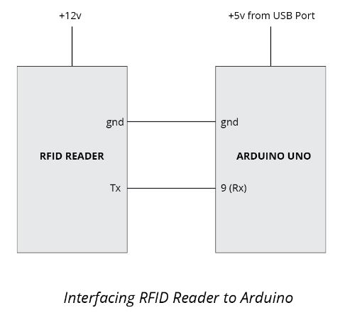
RFID Reader Module Interface
Here is the RFID Reader Module Interference with the Arduino.
The RFID Reader Module is biased to +12V using an external source or to +5V using the Arduino supply.
The output of Reader is connected to the RX port of the Arduino Board.
The output is sensed through this port

Slide 8
Block Diagram
DETECT RFID SIGNAL
RFIDTAG
IR TRANSMITTER
ARDUINO
MICROCONTROLLER
RGB LED
IR RECEIVER

Slide 9
Implementation
The IR Proximity Sensors are placed at regular intervals on the sides of the lanes.
We can decide the length of stagnant traffic on a road based on these sensors.
Based on this idea the traffic signal at that lane is prioritized.
If the traffic density is the same through all roads, the algorithm retorts to the conventional scheduling cycle.

Slide 10
Addition to the Project
In addition to the dynamic traffic signal scheduling, the system also detects an ambulance’s approach by reading the RF ID mounted on it.
A RFID reader module is place on every road which when detects an ambulance prioritizes that road’s signal first.
After the ambulance passes the signal, the system retorts to the conventional scheduling

Slide 11
Application
This project can be used to manage heavy vehicular traffic in metropolitan cities.

Slide 12
Importance
This robust system may replace the conventional traffic management system, thus eliminating the errs.
This implementation of this system reduces the road accident rates to a very great thresh.

